Slide 1
Planning for autonomous vehicles
The evolution of smart technology in Ohio and the current projects
By: Ferzan M. Ahmed, P.E.
Vice President, Ohio Transportation

Slide 2
THE STORY
Tell me about….OHIO
How it all started
City of Columbus -- Smart Columbus
Multi agency Smart corridor
Statewide -- Drive Ohio
Various efforts and projects, and how they tie together
AECOM’s role with Drive Ohio
EXAMPLES – What it all means

Slide 3
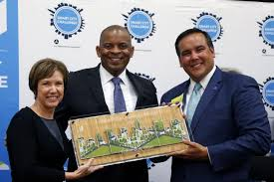
SMART COLUMBUS
It all started with “Smart Columbus”
@CNNTech June 23, 2016: 4:09 PM ET
Columbus wins $50 million DoT Smart Cities Challenge
U S DOT’s Smart City Challenge
Beat out six other cities
$50 million to implement a plan
Improve mobility through technology

Slide 4
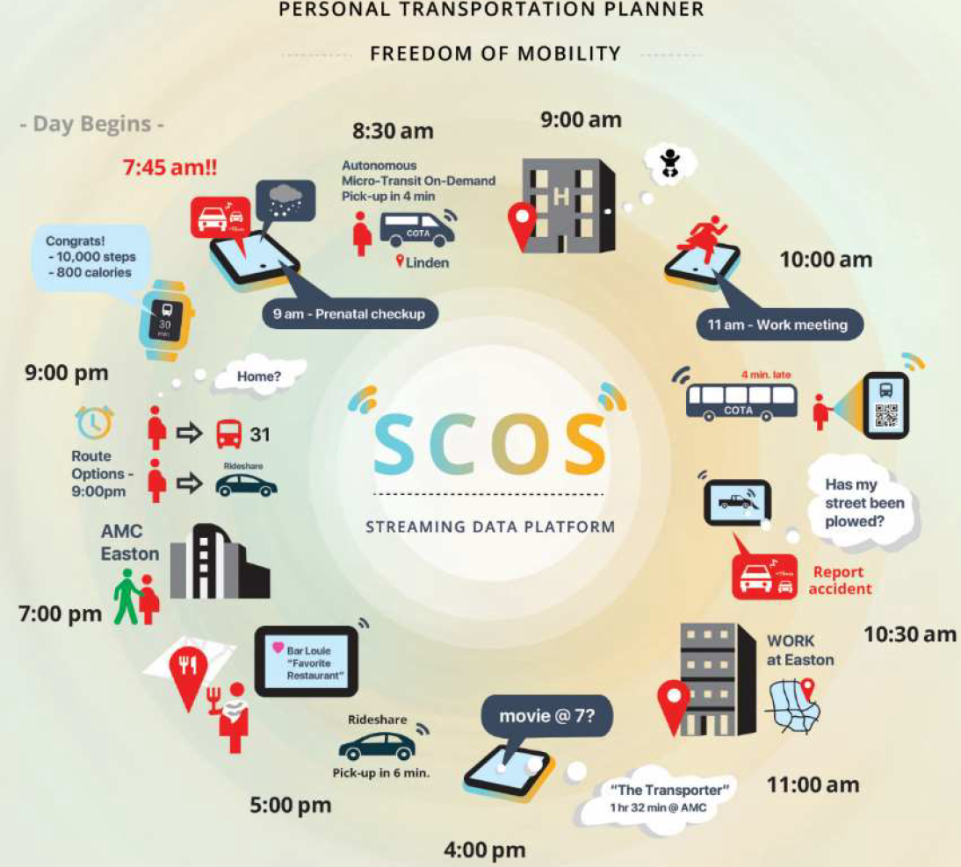
SMART COLUMBUS
Projects being developed:
SCOS (Smart City Operating System)
Mobility application
Solve current known problems

Slide 5
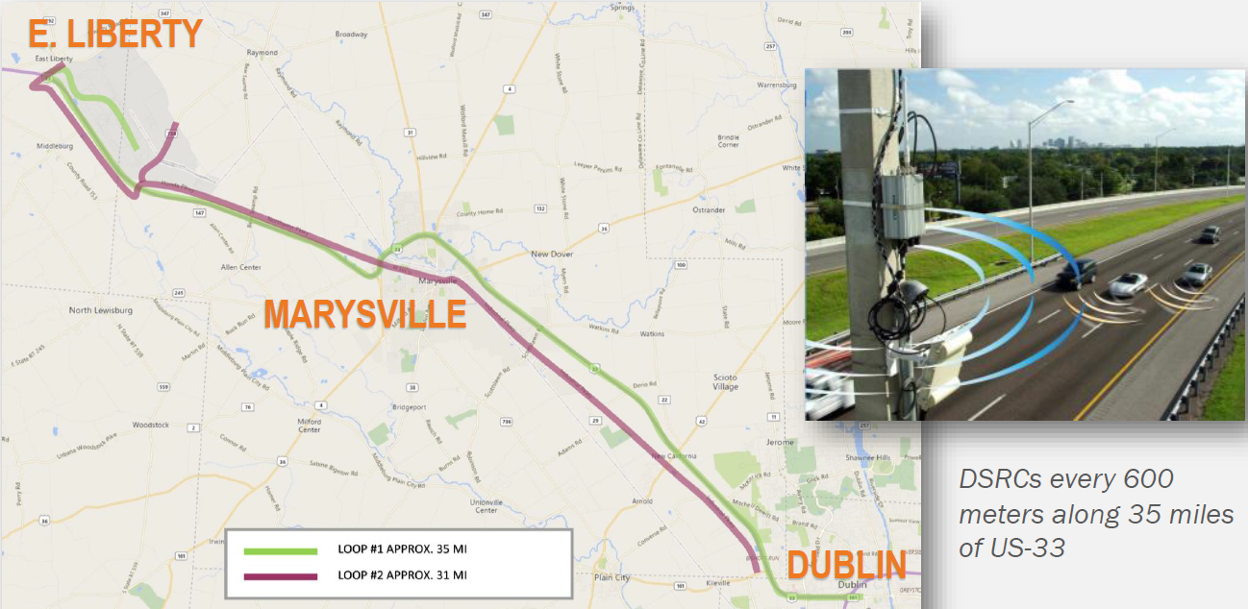
The 33 Smart Mobility Corridor
35-mile highway corridor just northwest of Columbus
3 counties (Franklin, Union, and Logan)
Connects the cities of Marysville and Dublin to Honda's North America Campus
Council of governments
Current projects
Fiber optic connectivity
ODOT enters the arena

Slide 6
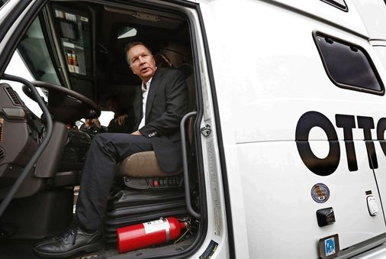
Drive Ohio
Gov. Kasich Launches DriveOhio with Executive Order
Created January 2018
Partnership between
ODOT and several state agencies
Mission: collaborate on
autonomous and connected
vehicle initiatives in Ohio

Slide 7
CREATE A STATEWIDE FRAMEWORK
Drive Ohio’s first initiative was to create a framework for all statewide deployments of automated technology
All other projects would be integrated with Drive Ohio
First of its kind in the country
COMPREHENSIVE SYSTEMS ENGINEERING ANALYSIS OF STATEWIDE ARCHITECTURE
Why this as a first step?
Required by Law for $$$ !
§ 23 CFR 940.11

Slide 8
§ 23 CFR 940.11
All ITS projects funded with highway trust funds shall be based on a systems engineering analysis
The analysis should be on a scale commensurate with the project scope
The analysis shall include
Identification of the regional ITS architecture
Identification of participating agencies’ roles and responsibilities
Requirements definitions
Analysis of alternative system configurations and technology options to meet requirements
Procurement options
Identification of applicable ITS standards and testing procedures

Slide 9
SYSTEMS ENGINEERING DEFINED
An interdisciplinary approach to realize a successful system
Focuses on defining customer needs and required functionality early in the development cycle
Develops documenting requirements
Proven advantages:
Reduces the risk of schedule and cost overruns
Increases the likelihood that the implementation will meet the user’s needs
Improved stakeholder participation
More adaptable, resilient systems 

Slide 10
ODOT / DRIVE OHIO’S GOALS
5
1
3
Statewide Framework
Resulting in SEA-AV/CV
AV/CV Data Storage
+Management + Security
Master Plan
AV/CV Communication
Infrastructure in Ohio
4
6
2
P3
Opportunities
Software Requirements
for an Ohio Integrated Data Exchange
Business Plan
Prioritize Future AV/CV Deployments

Slide 11
AECOM’S APPROACH
The vee method

Slide 12
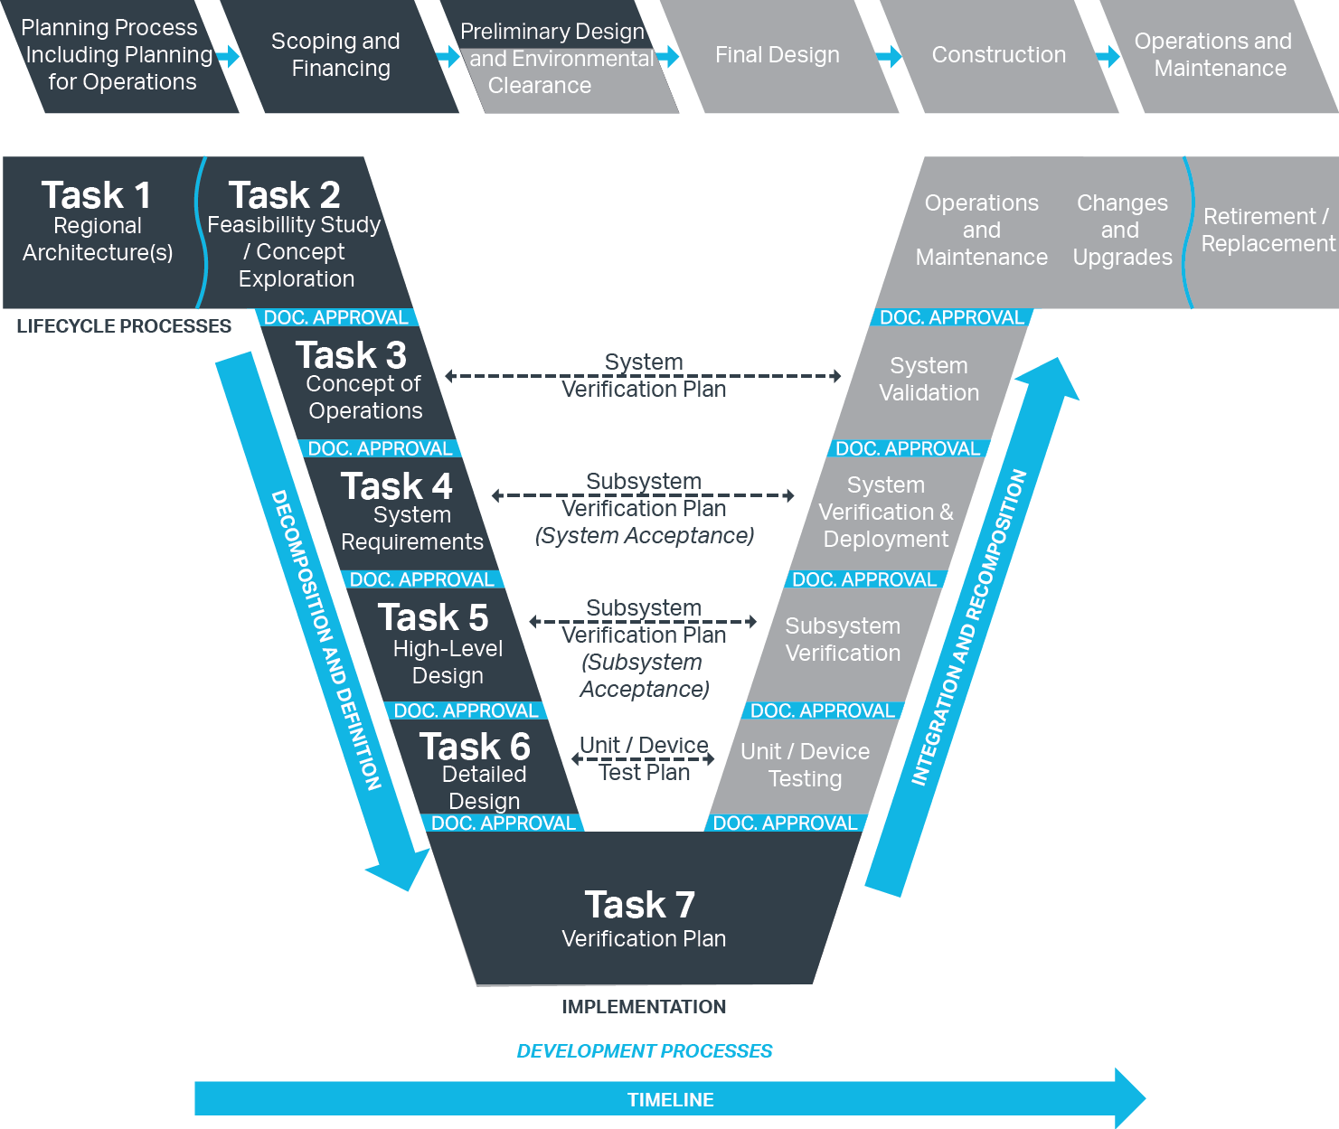
INITIAL TASKS
INITIAL TASKS:
LEFT SIDE OF
THE VEE

Slide 13
INITIAL TASKS EXPLAINED
Task 1: Architectures --- Update ITS architecture
Task 2: Feasibility --- Stakeholder Engagement (DOA!)
Task 3: ConOps --- High level stakeholder type document that describes target system and desired operation
Task 4: System Requirements --- Clearly defines how the system performs (MUST HAVES) Examples shown ahead
Task 5: High level design --- subsystem representation of the CV/AV components, but not the detailed design which represents the actual “built” elements
Task 6: Detail Design --- Defines components, down to device level

Slide 14
WHAT WILL PEOPLE SEE?

Slide 15
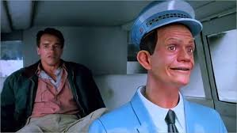
THE GRAND PRIZE

Slide 16
AUTONOMY, UTILITY AND SAFETY
Not just a shiny new toy
Focus on safety and options

Slide 17
AUTONOMY, UTILITY AND SAFETY
Not just a shiny new toy
Focus on safety and options

Slide 18
Thank You
Question & Answers

